Slide 1
System Operator Industry Forum
14 October 2025
Notes:
Tēnā koutou, tēnā koutou, nau mai, hoki mai
Hi and welcome to the SO Industry Forum
I’m […], one of the SO senior leadership team here at TP
Housekeeping:
Can you keep your camera and mic off for most of the presentation unless you are speaking
AI note takers – we’ve noted a few people using them on these sessions and often that results in everyone being spammed by the tool. . We won’t be letting AI notetaker tools into these meetings. And a reminder we do record these sessions, and the recording and slides go up on our webpage immediately after the session.
Questions
You are welcome to add any questions you have to the chat,. We welcome questions and will get to the questions at the end.
There are different levels of market or system understanding so please ask if you need more clarification –our experts are happy to explain points.
In some cases we may not be able to answer Qs directly, but we will take these away and either contact you directly or respond in the next briefing. We had one of those last week and we will respond to a couple of those Qs at the end.

Slide 2

Today’s agenda
Market and Operational updates
Key messages
Market update
NZGB update
Outage update – next 4 weeks
Operational update – Tokaanu Black Start
Consultations, publications and events
Questions / Patai
Notes:
Usual agenda -

Slide 3

Key Messages
Nationally hydro storage is above the historic mean for this time of year due to increased inflows.
Continued focus on fuel (both hydro and thermal) and asset availability is needed to reduce energy and capacity risks going into 2026.
Moving into spring we have seen demand soften due to warmer weather but are also seeing less firm generation in the stack due to outages and Huntly 5 not running as baseload.

Slide 4
Market update
Notes:
Niamh Scott – Market Analyst

Slide 5
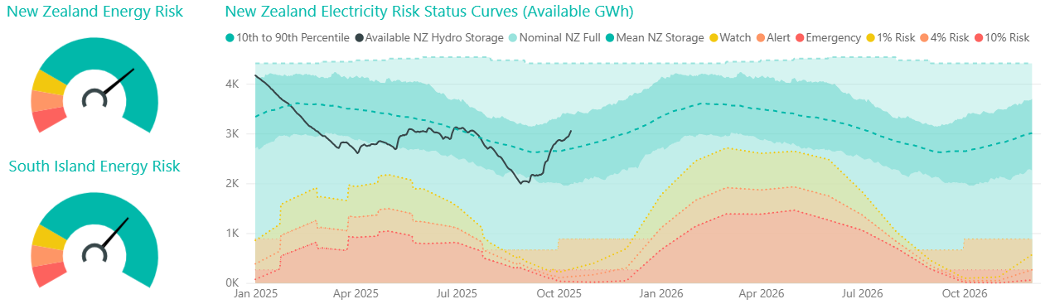
Energy: National hydro storage
 | Hydro storage level (% of mean▲/▼)
 | New Zealand | South Island | North Island
Last forum | 107% | 102% | 137%
Now | 115% ▲ | 112% ▲ | 135% ▼
Note: these numbers include contingent storage, so they differ from those reported by NZX

Slide 6
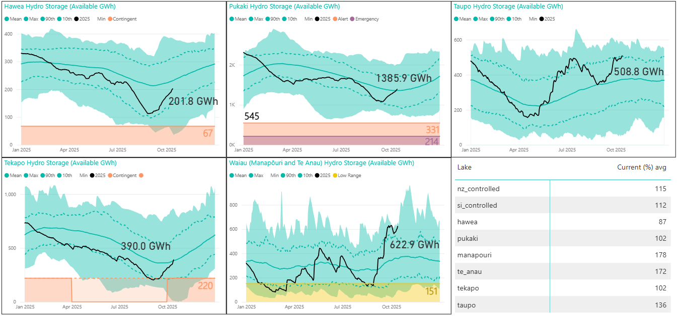
Hydro storage by catchment

Slide 7
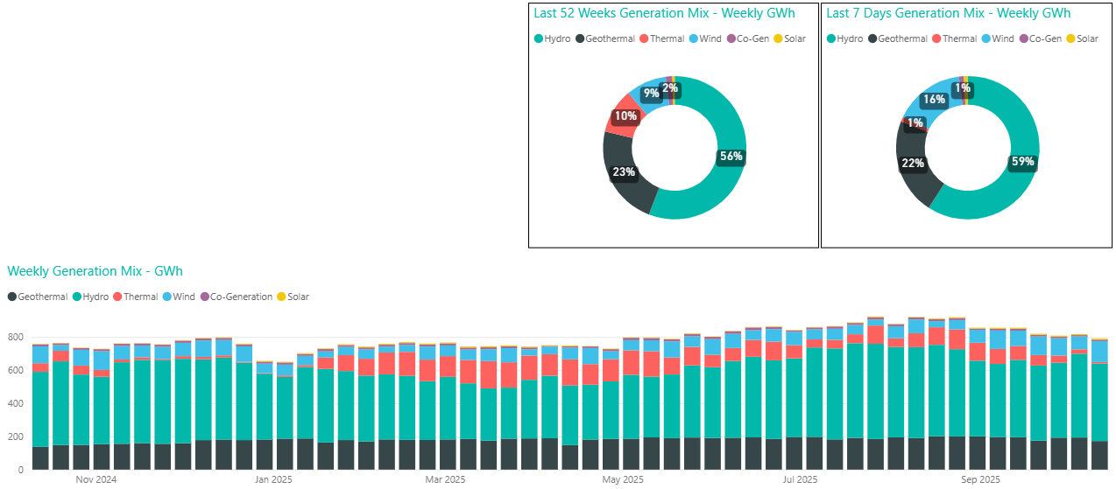
Generation mix
  Hydro generation share above average at 59%.
  Wind generation above average at 16%
  Thermal declined to just 1%
  Geothermal slightly below average at 22% with planned outages
Notes:
98% gen mix renewable
HLY 5 off line

Slide 8
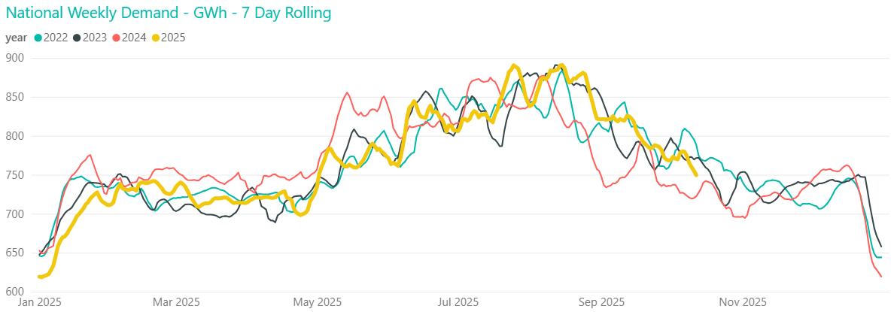
Demand
Declining demand with warmer weather and daylight savings
750 GWh last week, and 778 GWh the week before

Slide 9
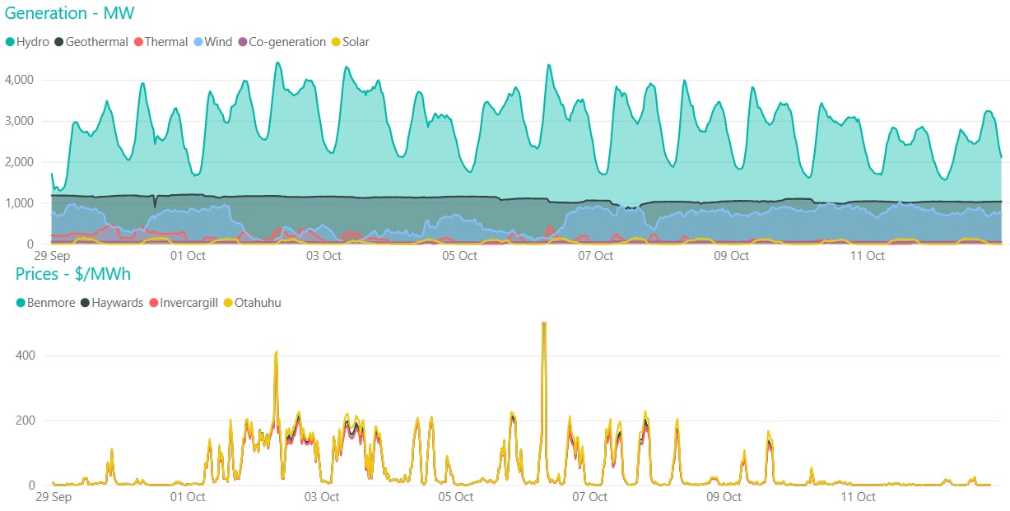
Pricing
Average Ōtāhuhu price was $34/MWh last week, and $65/MWh the week prior
Peak of $1193/MWh at Ōtāhuhu, 8am on Monday 6 October
Volatile prices
Notes:
Wholesale prices peaked during highest demand and lowest residual period of the week
With higher hydro storage price volatility has increased, typically up around $200 over periods of peak demand or low wind, and dropping off the rest of the time

Slide 10
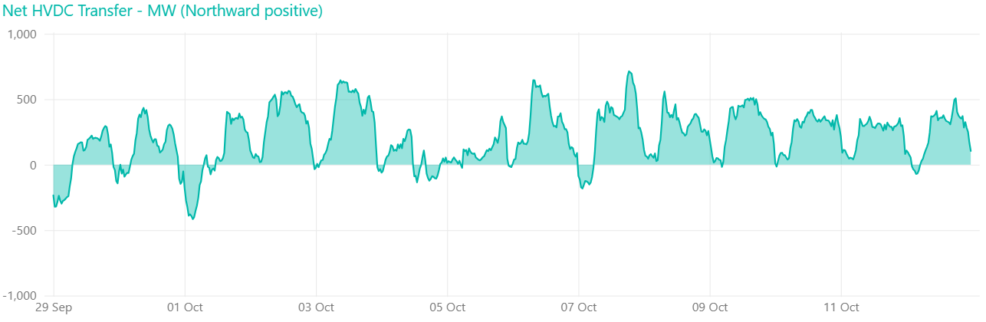
HVDC transfer
  77 GWh sent north and 6 GWh south over past fortnight.

Slide 11
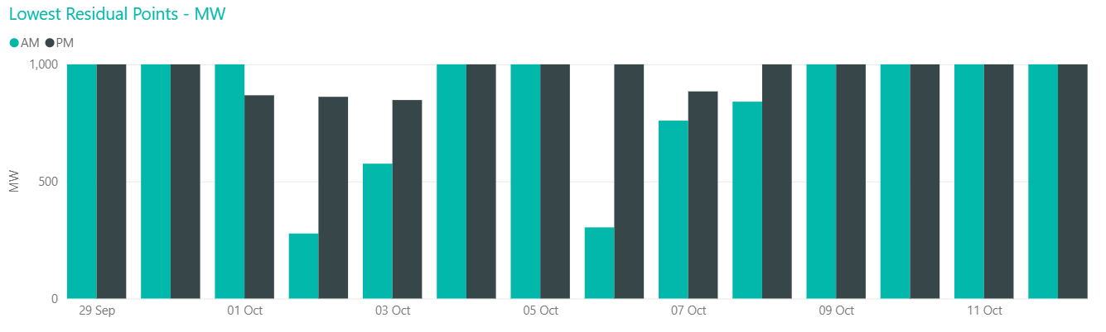
Capacity residual margins
  Mostly healthy residual margins in line with decreasing demand
  Lowest residual 300 MW during 2 October morning peak
Notes:
As we move further into spring we continue monitoring capacity closely despite a decrease in peak demand meaning most of the time the residual is healthy. During the shoulder seasons with an increase in outages, reduced thermal unit commitment, and continued possibility of cold snaps or large swings in output from wind generation, capacity can still be tight despite much lower demand.

Slide 12
NZGB update
Notes:
Theo

Slide 13
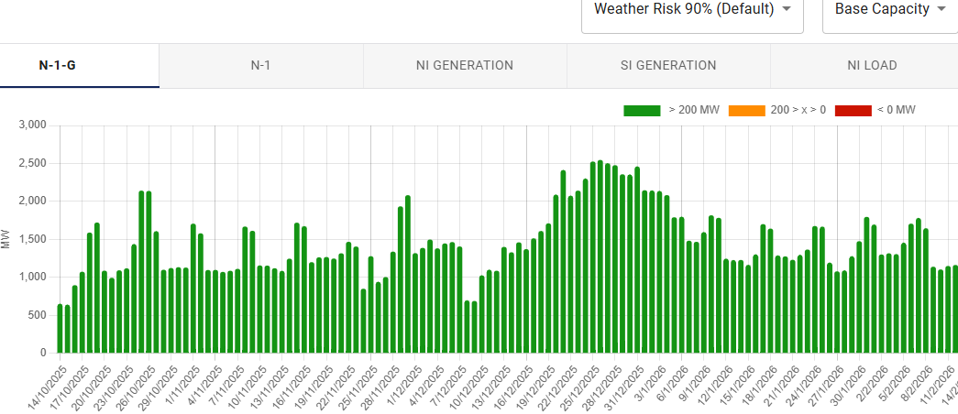
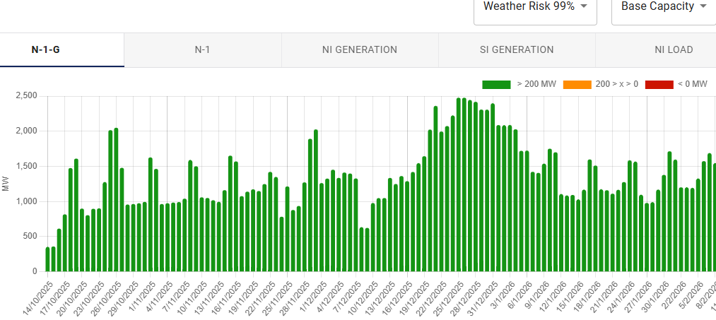
NZGB update: base capacity N-1-G
N-1-G margins are currently showing healthy values
Under the 99th percentile load, which we would expect under a cold snap, the margins drop but are still healthy
Base case capacity at 90%
This triggers the CAN process
Assumes all generation available in POCP is offered
It uses 20% of total wind capacity
90th percentile load
99th percentile load

Slide 14
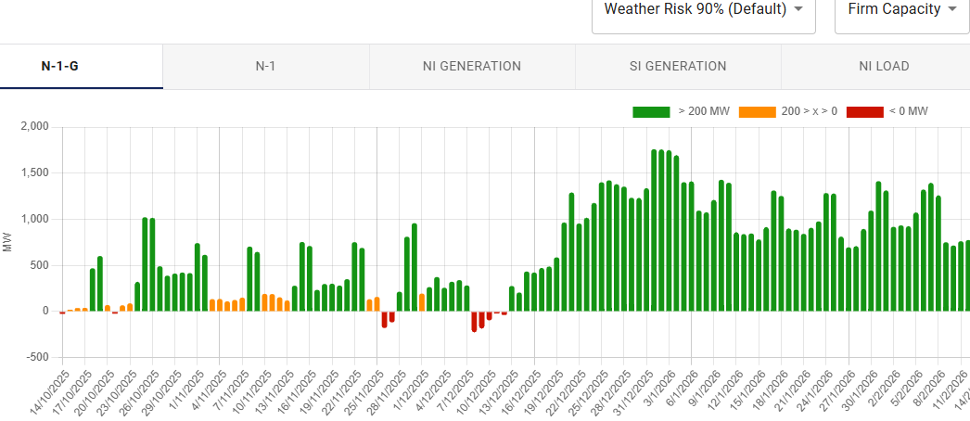
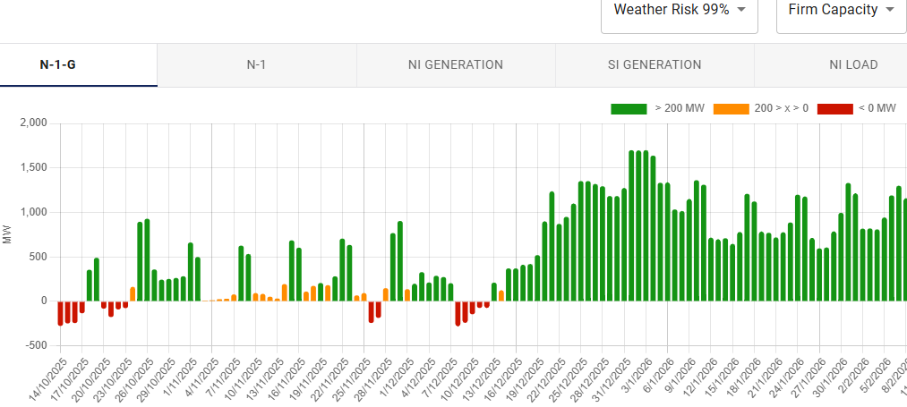
NZGB update: firm capacity only N-1-G
Firm capacity scenario reflects units that historically operate for at least 90% of AM & PM peaks.
Any shortfall or low margin periods highlight the potential reliance on these units to be available to cover N-1-G
This means we are relying on the market to coordinate especially slow starting thermal units, to get through high peak load periods
Firm capacity removes
TCC (-360MW) all months
HLY 5 (-405MW)
2 HLY Rankines from 1st Oct to 31 Dec 2025, and 2 Rankines over the remaining months
It uses the lowest 10th percentile generation for wind (8% of total capacity)
THI-WKM-1 outage
WKM-WRK-1 outage
90th percentile load
99th percentile load

Slide 15
NZGB update: Information
Recommendations from SO:
Avoid further outages during periods with low margins
Market coordination is required from industry to ensure available generation capacity remains high to cover potential cold snaps
Keep POCP updated with scheduled or tentative outages
Keep the WDS up to date with the latest offers
Any other information on plant availability, please contact the SO

Slide 16
Outages next 4 weeks
Notes:
Theo

Slide 17
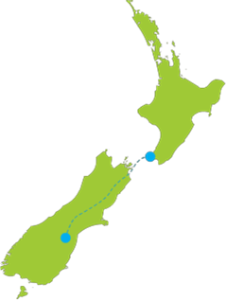
Outages
NNI outages
SNI outages
SI outages
NNI
SNI
HVDC
SI
Asset owners
Check in POCP for detailed dates
Consider the impact on your own outages
Notes:
2081 individual equipment outages across NZ between Sept and Dec 25
All in POCP
This is some of the major ones.
For Asset owners you can check in POCP for outage dates and consider the impact on your own outages.

Slide 18
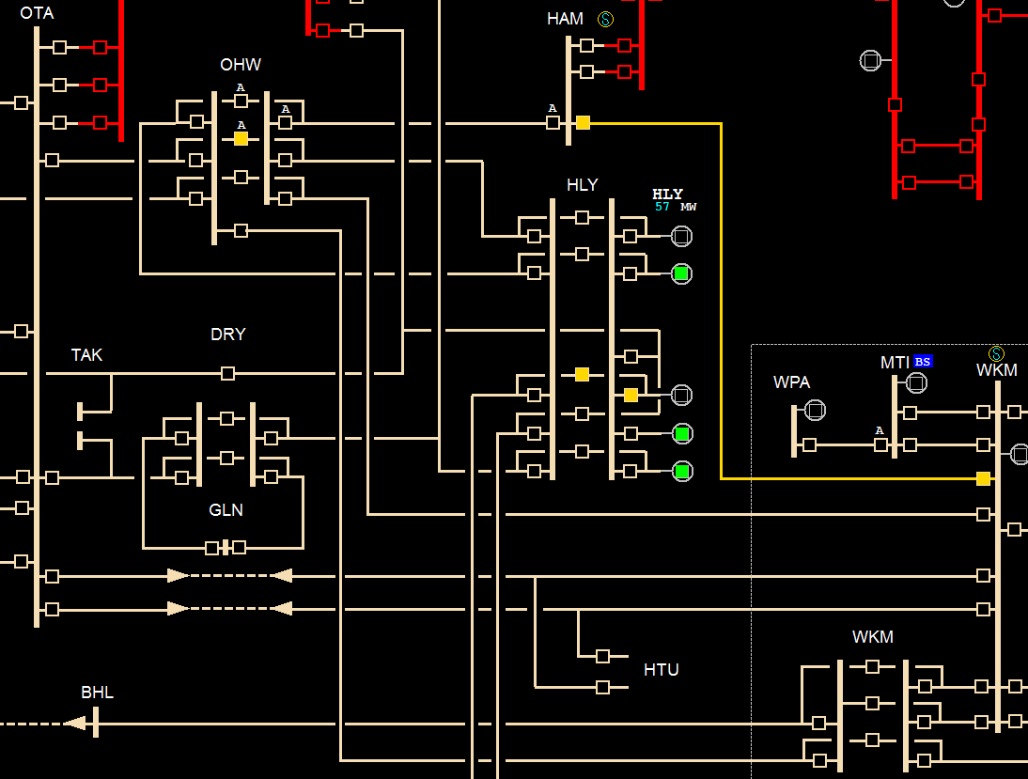
NNI Outages
Week of 20 Oct
  None
Week of 27 Oct
  HAM_WKM_1
Week of 3 Nov
  OTA_PAK_4
  OTA_TIE_5
  DRY_BOB_HLY_1
Week of 10 Nov
  DRY_BOB_HLY_2
  OTA_HTU_WKM_2
  HAM_T6
Notes:
27 Oct
Waikato on N-security and Causes generation constraints in Waikato 110kV
3 Nov
Potential voltage management into Auckland
10 Nov
Potential voltage management into Auckland
Causes generation constraints in Waikato 110kV

Slide 19
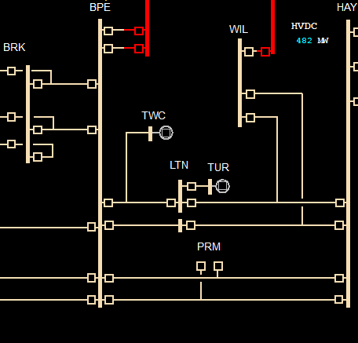
SNI Outages
Week of 20 Oct
  SFD_TMN_1
  TAB_WRK_1
Week of 27 Oct
  TMN_TWH _1
  OHW_WKM_1
Week of 3 Nov
  ATI_WKM_1
  RPO_TNG_1
  BPE_PRM_HAY_1
Week of 10 Nov
  RPO_WRK_1
  BPE_PRM_HAY_1
Notes:
20 Oct
TAB_WRK outage puts Tauhara, Harapaki, Whirinaki and Waikaremoana generation on N-security. Can set the risk
27 Oct
Parallel circuits into NNI
3 Nov
First WRK ring outage,
HVDC limit reduced
10 Nov
HVDC limit reduced

Slide 20
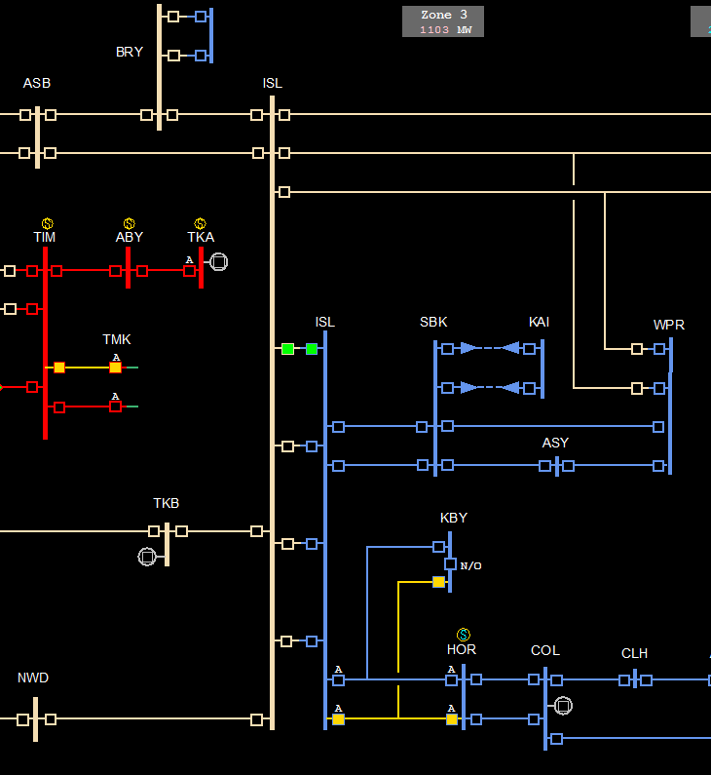
SI Outages
Week of 20 Oct
  ASB_BRY_1
  INV_ROX_1
  INV_ MAN_1
Week of 27 Oct
  ROX_TMH_2 followed by ROX_TMH_1
  NMA_GOR_TMH_2
  NMA_TWI_1
Week of 3 Nov
  ISL_KIK_1
  INV_ROX_2
  MAN_NMA_3
Week of 10 Nov
  BRY_ISL_1
  NMA_GOR_TMH_1
  INV_ MAN_2
Notes:
Week 1 and Week 4 we have ASB_BRY and BRY_ISL outages that have an impact on voltage stability in the upper South Island. This can be managed by generation and controllable load.
All 4 weeks have multiple concurrent outages in the lower south island that could constrain on generation in the area.

Slide 21
HVDC North transfer limit
Notes:
Having SC3 & SC4 out reduces the HVDC limit by 100MW in north transfer and 50MW in south transfer.
SC9 out reduces the HVDC limit by a further 100MW in north transfer and 50MW in south transfer
HVDC equipment outages and Lower NI AC line outages affect the HVDC limit.
Why do we care if the HVDC hits it’s limits? Residual and reserves are impacted. In a dry scenario with south transfer more SI generation will be required and in the market there is price separation between the islands.

Slide 22
Operational update – Tokaanu Black Start Test
Notes:
Matt Hansen – NCC Ops Manager

Slide 23
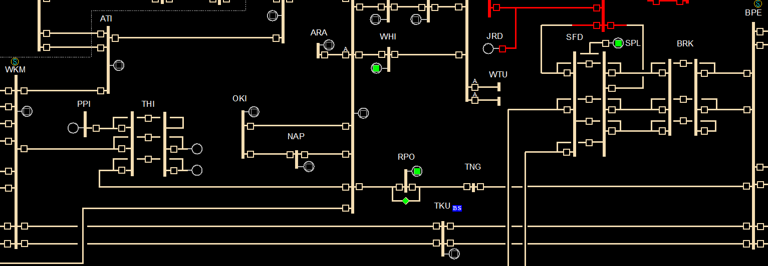


Tokaanu (TKU) Black Start Test

Slide 24
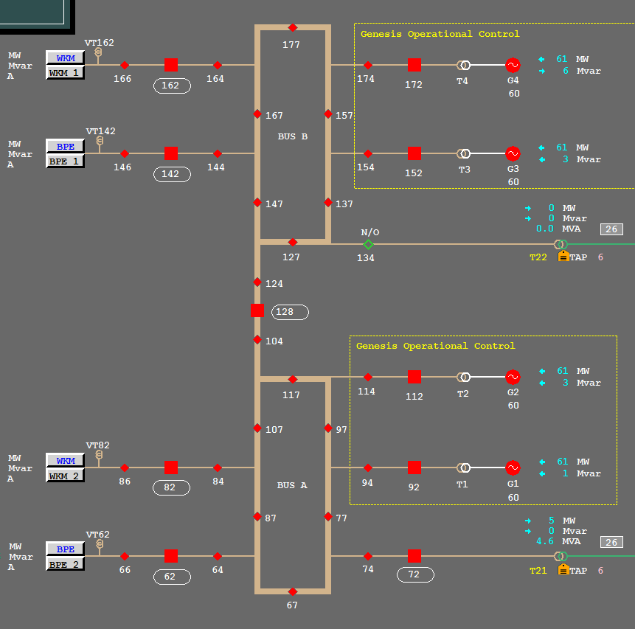
Tokaanu (TKU) Black Start Test

Slide 25
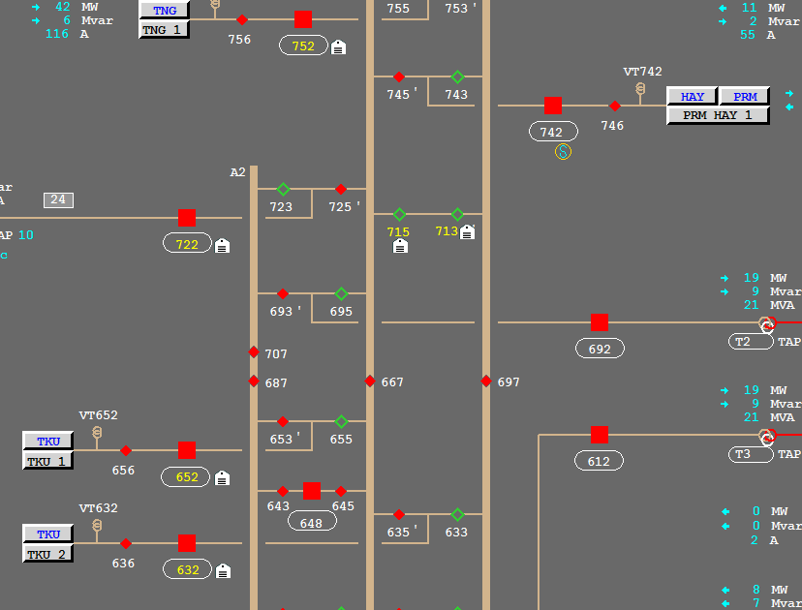


Tokaanu (TKU) Black Start Testing

Slide 26
Consultations, publications, and events

Slide 27

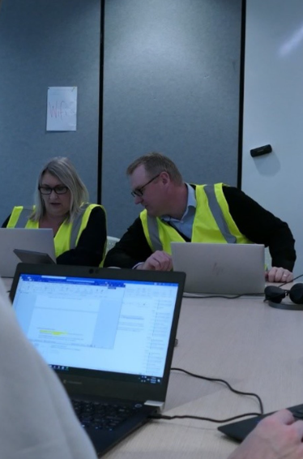
Consultations, publications, and events
Our draft SOSFIP amendment proposal consultation is now open. Submissions are due by 5pm Tuesday 4 November, followed by a week for cross-submissions.
Our 2025 Ancillary Services tender is now open. We are contracting for Instantaneous Reserves, Frequency Keeping (MFK and BSFK), and North Island Black Start services. Tenders close 5pm, Wednesday, 5 November.
We will publish the next Quarterly Security of Supply Outlook later this month.
The September Energy Security Outlook is available on our website.
Transpower is facilitating the fourth biennial GridEx exercise in November, for more information or to register contact: GridEx@transpower.co.nz.
Notes:
GridEx is an exercise simulating a cyber and physical security emergency and requiring participants to work through a real-time response.

Slide 28
Questions / Patai
Please raise your hand
If you have feedback let us know via our Feedback Form

Slide 29
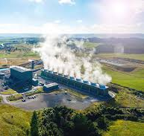
Operations Update: Inflexible Generation Outcomes
We’ve spoken previously about priorities when dispatching generation down within a constrained area or during low demand situations.
SPD looks for the most economic solution. It doesn’t account for the physical limitations of generating plant and their ability to consistently vary or generate at very low levels.
When generation is offered at the same price, infeasible dispatch solutions can arise, at which point NCC can use discretion to produce a viable outcome.
A general priority is intermittent generation off first, then hydro and thermal down to minimum run (if required on for security reasons), and lastly, geothermal.
Notes:
Tim

Slide 30
North Canterbury 66kV Special Protection Scheme
Notes:
Theo Kleynhans – Senior Operations Planner

Slide 31
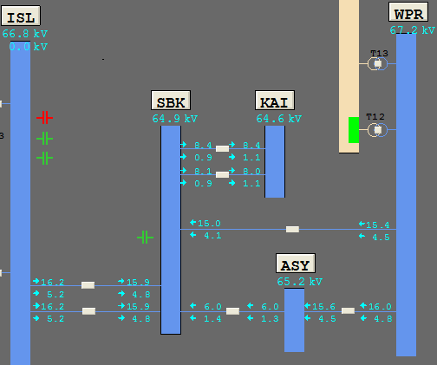
North Canterbury 66kV Circuit Overload Protection Scheme (COPS)
The scheme involves four sub schemes, one on each of the following circuits:
• Islington–Southbrook 1
• Islington–Southbrook 2
• Ashley–Waipara 1
• Southbrook–Waipara 1
 | N-1-1 (One Planned outage and a tripping)
Without SPS | Load management from ASY, SBK, KAI ≤ 77MW to 80MW
With SPS | More flow to ASY, SBK, KAI up to 133MW (70% more flow into the region)
This COPS will disconnect any overloaded circuit if there is a tripping on the remaining network during a planned outage on the 66kV network

Slide 32
Fortnightly Operations Update
Other
Number Unplanned Outages (EXN) | 12
Number Under Frequency Events | 0
Number Grid Emergencies (GEN) | 0
Low Residual / Shortfall Situations | 1
6/7 August – Hawkes Bay Restoration Workshop
13 August – Brief Transpower ICCP outage
19 August – Insufficient transmission capacity Hawkes Bay (20/8)
Short Summary of Unplanned Outages
5 August - Edgecumbe Kawerau 1 Auto-reclosed 7 August - Edgecumbe Owhata 2 Auto-reclosed 7 August - Ohakuri Wairakei 1 Auto-reclosed 11 August - Bream Bay T2 Tripped 12 August - Tiwai Reduction Line Tripped 13 August - Matahina Generation Tripped 14 August - Ashburton Timaru Twizel 2 Auto-reclosed 16 August - Penrose STC 1A Tripped, Penrose STC 1B Tripped 17 August - Wanganui Waverley Auto-reclosed 18 August - Islington Southbrook 1 Auto-reclosed 18 August - Tiwai Reduction Line Tripped 18 August - Huirangi T6 Tripped 19 August - WRN Insufficient transmission capacity Hawkes Bay (20/8)
Looking Ahead
NCC Team Training in Progress (Round 2)
GSO Team Forum (Oct)
For the fortnight August 5th – 17th 2025

Slide 33
CACTIS Consultation
Notes:
Kevin Wronski

Slide 34



Consultation Open: Proposed Connecting Asset Commissioning Testing and Information Standard (CACTIS)
Part of Authority's Future System Resilience Programme
Based on Technical Codes A and C
Revised technical requirements for asset owners
CACTIS covers:
Timeframes
Commissioning Plans
Asset Capability Statements
Modelling
Connection Studies
Test Plans
Testing
Operational Communications
High Speed Data
Notes:
Yesterday we opened our consultation into the proposed Connecting Asset Commissioning Testing and Information Standard, or CACTIS.
We would like to invite you and your teams to comment on what we have put forward.
We are proposing to migrate and update certain sections of Technical Codes A and C into the CACTIS. On the bottom half of your screen, you’ll see that we have organised the asset owner requirements into chapters.
Some of the requirements are new, others have been updated, while we’ve left others unchanged.
Our consultation document, which you can see on the top right, explains the rationale for what we have added or updated. We also have an appendix summarising what has been kept the same.

Slide 35



Consultation Open: Proposed Connecting Asset Commissioning Testing and Information Standard (CACTIS)
Supports system security
Improves consistency and enforceability
Leads to more responsive Code updates
Accelerates integration of new technologies
Aligns with industry trends
We welcome your feedback!
See the System Operator Consultations webpage.
Closing date: 5pm, Monday 29 September 2025
Notes:
Why are we proposing the changes in the CACTIS?
As you can see on the screen, we are trying to clarify the technical requirements for many reasons. Under the current Code, as many of you are aware, we strive to meet our principal performance obligations. But with more and more participants wanting to join the system, upgrade their assets or perform routine testing, the energy landscape is also becoming more complex to coordinate.
To continue to operate the power system safely and reliably, we now need access to clearer, more detailed and accurate asset information delivered on time, and the proposed CACTIS will allow us to not just to keep pace with the changes across the industry, but plan ahead and ensure we deliver a robust service for all stakeholders.
We therefore want to hear from you. Our System Operator Consultations webpage has all the details you need to make a submission. And just a note: the Electricity Authority has already run their own consultation on this document between 1 July and 12 August. We have summarised the feedback they have received in the appendix to our consultation document, and will consider it along with any more feedback we get, to prepare our recommendations to the Electricity Authority.
Our consultation closes on September 29, and we expect the Electricity Authority to make their final decision in December of this year. Any questions, sing out.

Slide 36
Outage update
Notes:
Minura – Planning & Project Support Manager

Slide 37
Asset owners
Outages
LNI outages impacting HVDC limits
USI outages
Wairakei ring outages
WRK Ring
LNI
Check in POCP for detailed dates
Consider the impact on your own outages
USI
Notes:
2081 individual equipment outages across NZ between Sept and Dec 25
All in POCP
This is some of the major ones.
For Asset owners you can check in POCP for outage dates and consider the impact on your own outages.

Slide 38
LNI Outages
HAY SC3 & SC4 – 11 months
HAY_WIL_LTN_1
HAY_WIL_LTN_2
BPE_PRM_HAY_1 for 2 individual weeks
BPE_PRM_HAY_2 for 2 individual weeks
BPE_TNG_1
HAY_T1
HAY_WIL_LTN_1 (JFD_WIL_1)
HAY_T5
HAY_WIL_LTN_2
BPE_TKU_1
Notes:
A sample of LNI outages.
Outages that will affect the HVDC transfer limit. Dates are in POCP.
Need to get done prior to starting TKU_WKM outages in 2026 which will take resource.

Slide 39
HVDC North transfer limit
102 days between 800 and 1000MW
Annual HVDC Outage
Notes:
all outages at 1 August 25
Having SC3 & SC4 out reduces the HVDC limit by 100MW in north transfer and 50MW in south transfer.
HVDC equipment outages and Lower NI AC line outages affect the HVDC limit.
Why do we care if the HVDC hits it’s limits? Residual and reserves are impacted. In a dry scenario with south transfer more SI generation will be required and in the market there is price separation between the islands.

Slide 40
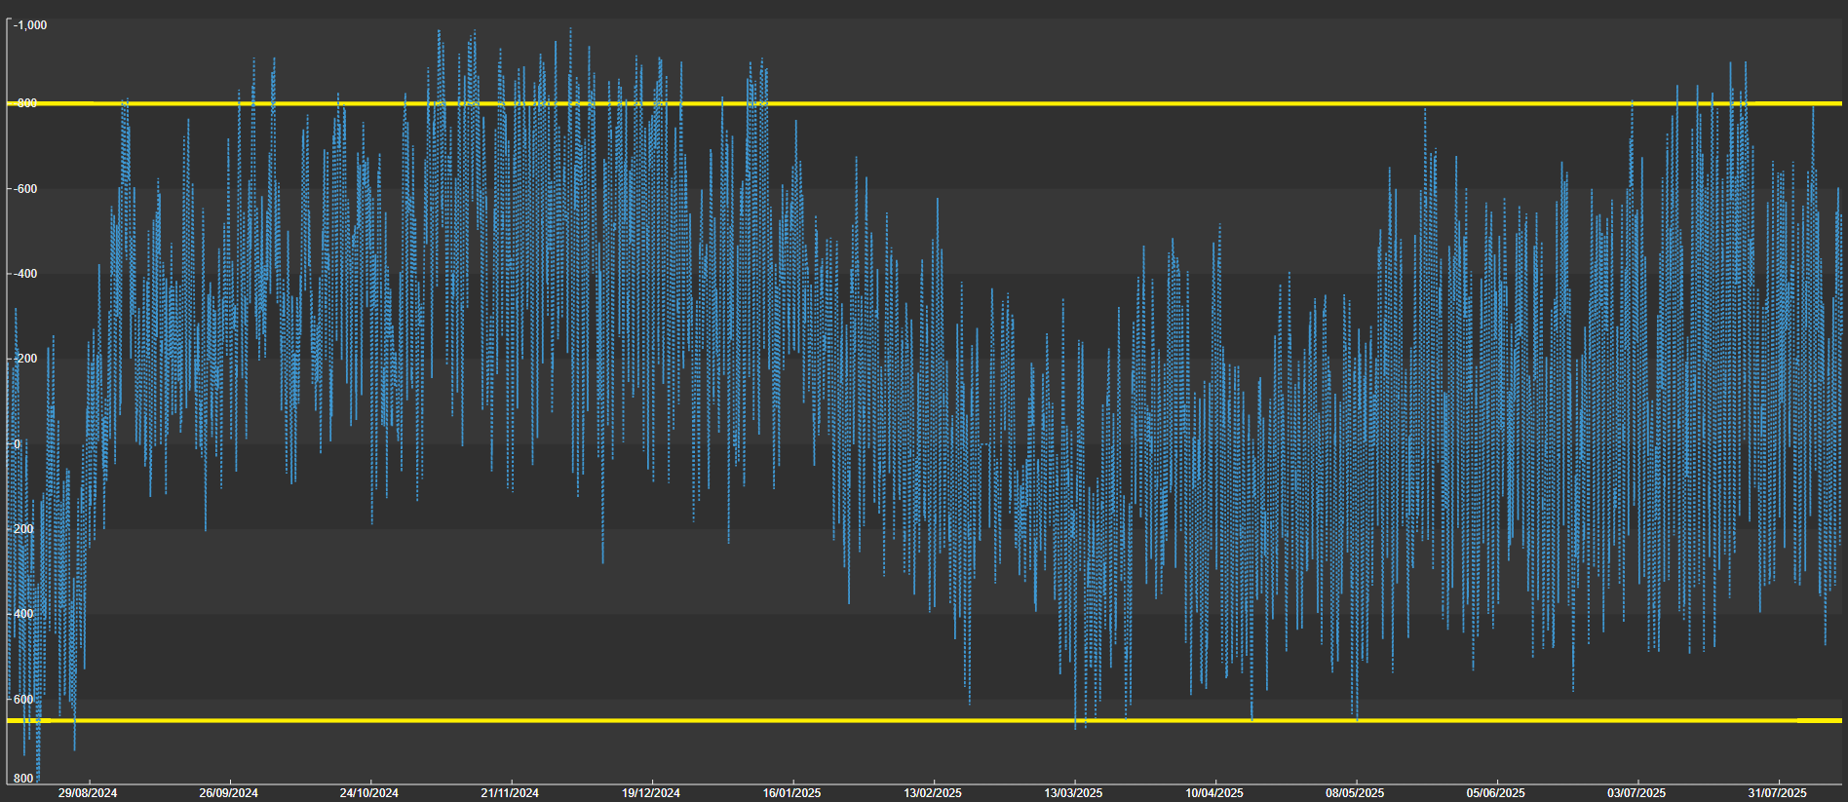
HVDC transfer
HVDC North 800MW
800MW
HVDC South Limit
650MW
Notes:
For the last year’s HVDC transfer the majority of transfer is well within the reduced transfer range with current outages.
Start is low SI lake levels.
Past performance is not a guaranteed indicator of future performance.

Slide 41
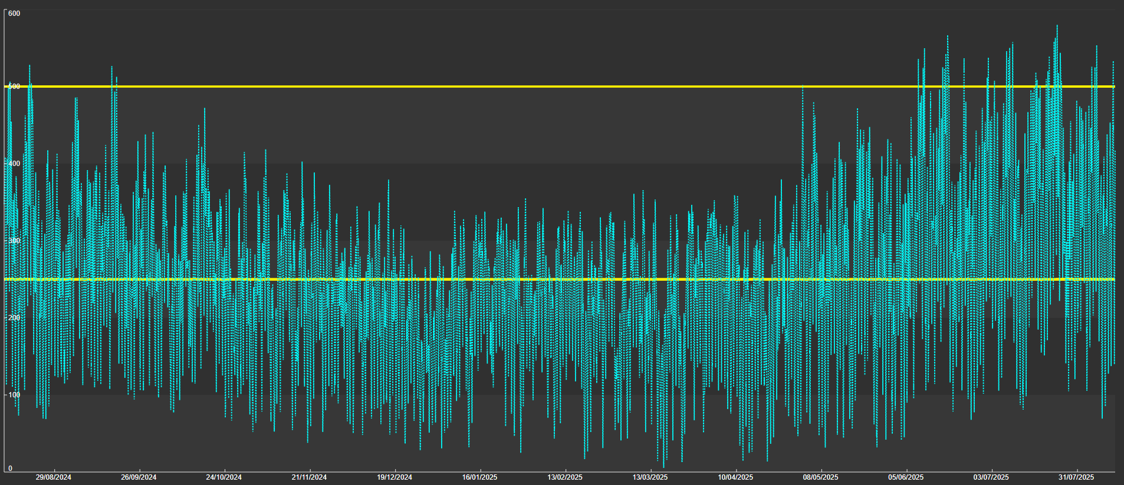
Wellington load for HVDC
No impact on HVDC limit North
500MW
Sliding impact on HDVC limit
250MW
Full impact on HVDC limit North
Notes:
Two yellow lines represent 500MW and 250MW.
The blue is a year of Wellington load data.
Above 500MW there is no north flow impact. Between 250MW & 500MW there is some impact proportional to actual wellington load. Below 250MW the impact is the full 100MW reduction. Most of the time the peak loads are in the propo

Slide 42
USI Outages
These outages impact Voltage Stability limits
ISL_TKB (1-7/9)
ASB_ISL_1 for 3 weeks (8-26/9)
ISL_NWD_1 (29/9-3/10)
BRY_ISL_1 (10-13/11)
ASB_BRY_1 for 2 weeks (24/11-5/12)
ISL_SBK_1 & 2 for 6 weeks of reconductoring (15/9-24/10)
Note: For LSI outages coming up we will be engaging the Asset Owners due to the developing lower lake levels
Notes:
A sample of SI outages.
Sept USI outages have had POCP’s issued as VSAT can be an issue if the USI loads are high.
ISL_SBK 1 & 2 is TTU work and will have a Nth Cant SPS installed prior.
More outages for LSI, north of ISL and WC

Slide 43
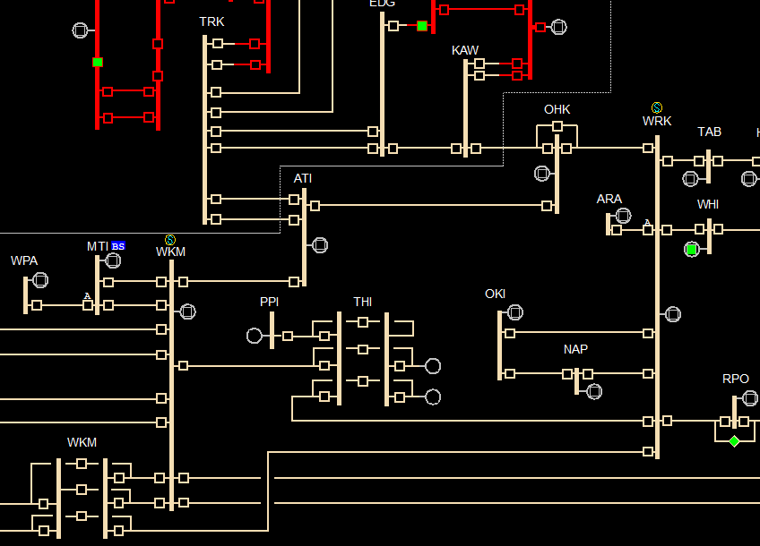
WRK Ring Outages
These Outages can have a significant impact on generation connected to the Wairakei ring
ATI_WKM_1 (4-7/11)
OHK_WRK_1 (20/11)
THI_WKM_1 (26-27/11)
THI_WRK_1 (6-7/12)
WKM_WRK_1 (8-14/12)
Notes:
WRK ring outages. Nov-Dec 25. These outages can impact the generation connected to the WRK ring depending on how generation profiles are combined with UNI generation profiles and load.
ATI_WKM_1 - 4 to 7/11, 10 year mtce CB192 WKM
OHK_WRK_1 – 20/11, mtce
THI_WKM_1 – 26 & 27/11, multiple mtce
THI_WRK_1 – 6 & 7/12, multiple mtce
WKM_WRK_1 – 8 to 14/12, multiple mtce

Slide 44
SO Generation Commissioning & Testing update
Notes:
Anna

Slide 45
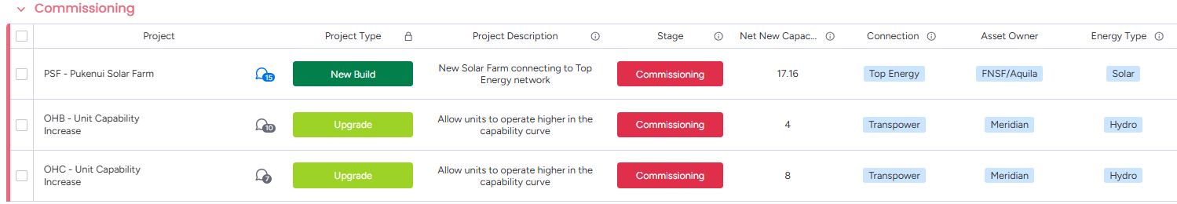
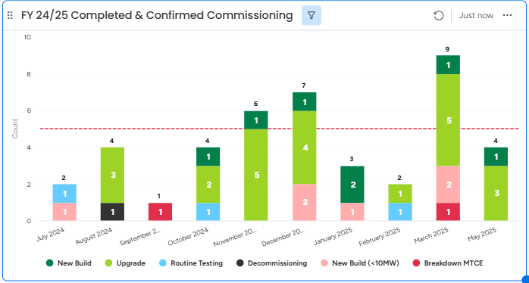
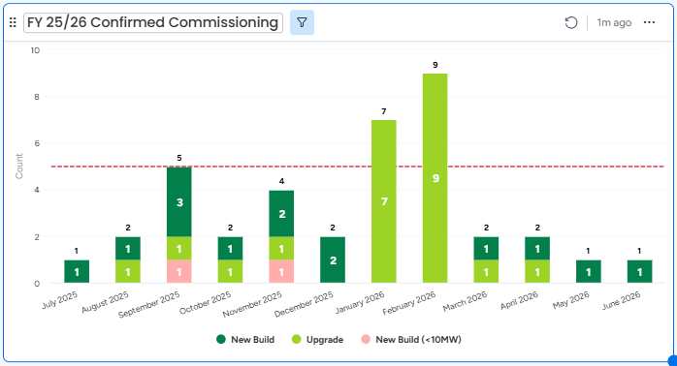
In-flight commissioning, routine testing & upgrade projects
Total Projects: 42
Total New MW: 299
Total Projects: 38
Total New MW: 932
Notes:
Here is the latest snapshot of our in-flight commissioning, routine testing & upgrade projects
Currently in the Commissioning space
PSF has commenced their commissioning testing in May
OHB and C is going through commissioning and testing to operate at the uplifted MW outputs later in June
Recently Completed Commissioning's
Ruakākā completed commissioning at the end of last month
Upcoming Commissioning's (Chart on the right)
10 new builds due to complete commissioning between now and the end of the year - which will bring on over 400MW of new generation capacity
The sooner Routine testing and commissioning
Since our last update, we have one upgrade project entering into the commissioning & testing pipeline with a planned synchronisation date in December.

Slide 46
Information published regarding meeting peak demand
Annual Security of Supply Assessment (SOSA)
Forecast winter energy and capacity margins relative to security standards
New Zealand Generation Balance (NZGB)
Generation margins for the next 200 days
Winter Outlook / Quarterly Security of Supply Outlook
Shape and size of energy and capacity risks for period
Forward market schedules (WDS, NRS, PRS)
Forecast market schedules, prices
Residual capacity
Real-time dispatch (RTD)
Sensitivity schedules
Wind generation forecast
Controllable load visibility
10 years
200 days
6 months
1 week
36 hours
4 hours
1 hour
5 mins
Real time
Notes:
Matt
Let’s first take a quick look at the information available to you.
Our Annual Security of Supply Assessment (SOSA) provides information on winter and capacity margins over the next 10 years.
NZGB provides a view of the next 200days, Theo will cover that in more detail shortly
Then there is the Quarterly Security of Supply outlook – which provides view of the next 6 months of energy and capacity risks
Before we get into the market schedules, and information available via WITS and EM6

Slide 47
Roster
Internal only
Date | Chair | Markets | Planning | Operational | Next chair | Comms | Impartiality / compliance | Tech Sec | Sponsor
1 Apr | Matt
15 April | David
29 April | Katherine
13 May | Rebecca
27 May | David
10 June | Matt
24 June | Katherine
8 July | Rebecca
22 July | David
5 August | Matt
19 August | Katherine
2 Sept | Rebecca
16 Sept | Matt
30 Sept | David
14 Oct | Rebecca
28 Oct

Slide 48
Process overview
Internal only
Activity | When | Who (lead in bold) | What
Prep | Tues 9.30am | Chair Presenters (Markets, Outages, Operations) Note does not need all 3 every week – could include PS as well) Assurance (Richard) Comms (Nathan) Tech Sec (Carol) | Confirming and checking material and roles (material should be pre-loaded) Reviewing answers to prev Q&A
2. Industry Forum | Tues 11am | Chair 3x Presenters (Markets, Outages, Operations) Note does not need all 3 every week – could include PS as well) Assurance (Richard) Comms (Nathan) Tech Sec (Carol) | Deliver forum!
3. Debrief | Tues 11.40am | Chair Presenters (Markets, Outages, Operations) Next chair Assurance (Richard) Comms (Nathan) Tech Sec (Carol) | Review feedback (internal and from audience) Assign owners to offline Q&A Identify opportunities to improve / change in future
4. Offline checks | Using Teams channel during alternate week | Tech Sec (Carol) Chair | Confirm attendees against roster Confirm horizon of diary invitations
 |  | Tech Sec (Carol) Comms (Nathan), Assurance (Richard), next Chair | Check progress of offline Q&A responses

Slide 49
1. Prep meeting – 9.30am Tuesday
Internal only
Chair to run this meeting and ensure checklist is covered
Checklist
Item | Confirmed by | Y / N
Every slide has a presenter (unless decided there is no update for an item) | Chair
Every slide has material (if there is no update for an item then say this on a placeholder slide) | Chair
Material is appropriate: SO independence | Assurance (Richard)
Material is appropriate: audience lens (relevance, tone, level of detail) | Comms (Nathan)
Material is appropriate: duration of presentation items < allocated timeslots | Chair
Q&A from last time: all questions have an answer or placeholder | Chair
Q&A from last time: assurance on all answers (SO independence, compliance risk) | Assurance (Richard)
Backup presenter and offline version of slides prepared | Tech Sec
Pre-check that all presenters have the right invitation | Chair

Slide 50
2. Industry Forum – 11am Tuesday
Internal only
Standing agenda
Item | Who | When | Duration
Welcome, housekeeping | Chair | 11.00am | 1
Introduction | Chair | 11.01am | 1
Markets update | Presenter 1 | 11.02am | 5
Outages update (System operator issues which have an impact on multiple industry participants) | Presenter 2 | 11.07am | 5
Operational update (System operator issues which have an impact on multiple industry participants) | Presenter 3 | 11.12am | 5
Projects & events New or upcoming project news Events (recent, upcoming) Other engagement (consultations, surveys) | Chair | 11.17am | 2
Q&A | Chair | 11.19am | 10
Close | Chair | 11.29am | 1

Slide 51
3. Debrief meeting – 11.40am Tuesday
Internal only
Chair to run this meeting and ensure checklist is covered
Checklist
Item | Confirmed by | Y / N
Feedback: All audience feedback is captured | Katherine | Y
Feedback: Reflections and feedback from internal team is captured |  | Y
Feedback: Any actions or decisions that have come from feedback have owners and deadlines |  | Y
Slides: Today’s presentation is saved in the archive | Carol
Slides: Blank presentation created for next time | Carol
Q&A: All unanswered questions added to next presentation | None
Q&A: All unanswered questions have owners assigned | N/A
Next Chair accepts handover

Slide 52
4. Offline checks (done between forums)
Internal only
Tech Sec owns and manages this slide
Checklist
Item | Confirmed by | Y / N
Confirm attendees rostered for the next 3 events | Tech Sec
Confirm diary appointments have been sent externally for the next 3 events | Tech Sec
Check progress of Q&A responses, actions and decisions and reports these to the next Chair by the Thursday before the next Forum | Tech Sec

Slide 53
Actions and decisions
Internal only
Tech Sec owns and manages this slide
Date created | Action or decision required | By when | Owner | Status/Update
15 Mar | Add link in slides to the SO website, note that full detail on all issues can be found there. Also, subscribe to comms there | 21 Mar | MH | Closed
22 Mar | How do we encourage more questions? | 4 Apr | KM | Closed
22 Mar | Send reminder for next forum the week before | 31 Mar | NG | Closed
22 Mar | Book presenting room in Waikoukou for the series | 25 Mar | CG | Closed
5 Apr | Clarify internally that these forums do not replace live event or industry conferences | 30 Apr | SH | Closed
3 May | Change 11am-12noon internal placeholder invitation to be 11.30-12noon, and change the title to “SO Industry Forum debrief” (to avoid confusion with the Forum teams invitation | 5 May | CG | Closed
3 May | Check that all of SLT have the invitation for all 3 sessions each fortnightly: prep session, forum, and debrief | 5 May | CG | Closed - yes they do
14 June | Prepare a forum to survey participants views and ideas on improvements | By next 28 June | MH/NG | Ongoing to be finalised by NG
13 Dec | Send invites out for 2023 – start 24 Jan | ASAP | MC | Closed – last meeting booked 13/12/2023

Slide 54
Questions to follow up
Internal only
Tech Sec owns and manages this slide
Date | Question | Answer | Stakeholder | Owner | Approved by Assurance (Y/N) | Approved by Comms (Y/N) | Approved by Chair or SLT Sponsor (Y/N)
24 Jan | [11:08 am] Gerard Demler Hi, it looks like the HVDC is reserve limited on Fri evening, can you please shed some light on why the limit is so low? Cheers |  | Gerard Demler | Matt Hansen
18 Apr | On that note - will new price sensitivity reports be inclusive of demand response load forecast? |  | Raul Henao | David Katz
13 Jun | Are you planning to prepare a market insights or something similar on the high SI scarcity prices |  | Philip Wong Too | David Katz

